Slide 1


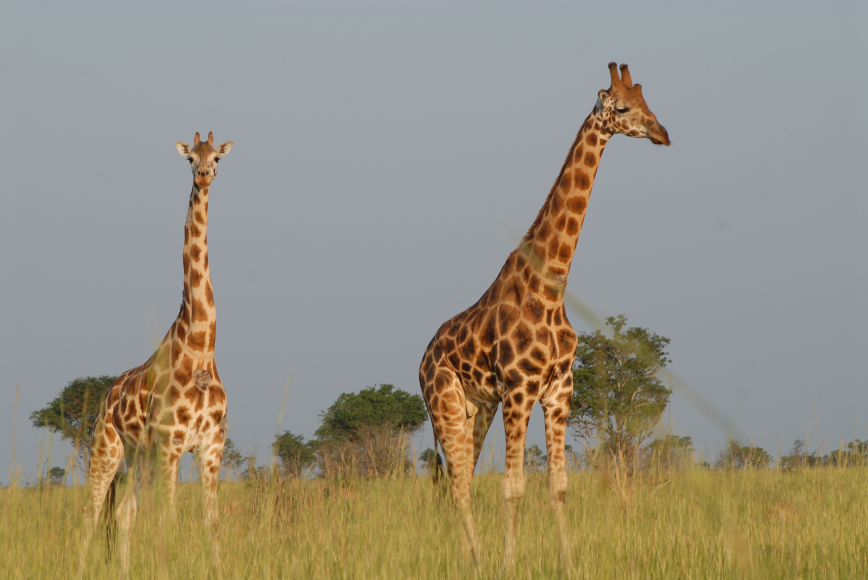
PDE Analysis of
Pattern Formation in
Biological Systems
Under The supervision of:
Dr. Muhammed Rushdy

Slide 2
Agenda
Overview on the BME problem
Explanation of the PDE model
Finite difference method (FDM)
Finite volume method (FVM)
Learning based method (ML code)
Comparison
Suggestions for Improvements and Future Work

Slide 3
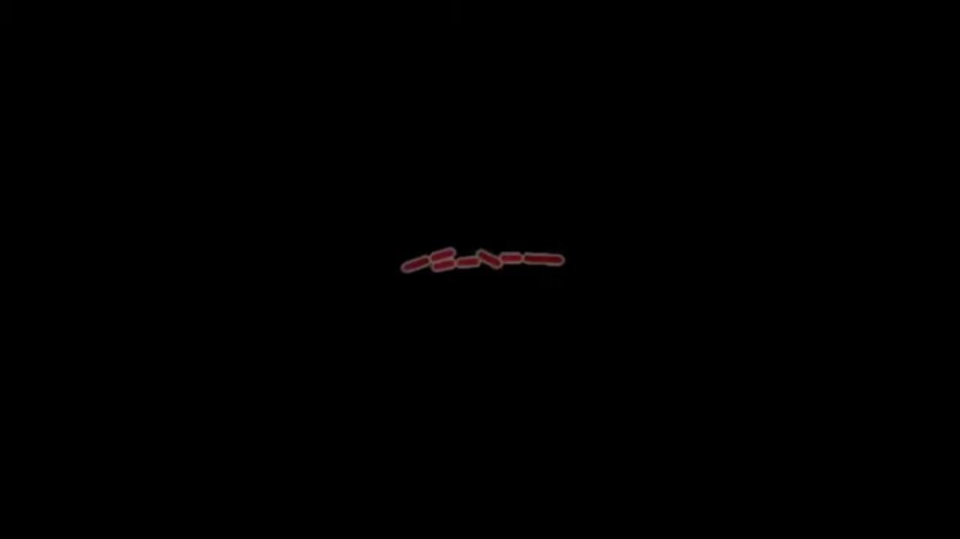

Slide 4
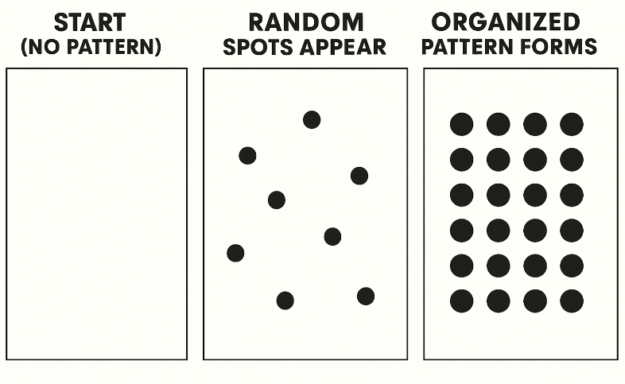
Overview
Pattern Formation: Cell's ability to self-organize uniform systems into structured, repeating arrangements
Examples: Zebra stripes, leopard spots, sand dunes.
How Patterns Emerge
Three essential ingredients:
Agents (Cells, chemicals)
Basic units that interact locally
Signals (Chemicals, proteins)
"Messages" that spread through diffusion
Feedback Loops
Self-reinforcing interactions:
Activation: "Make more like me"
Inhibition: "Stop nearby changes"

Slide 5
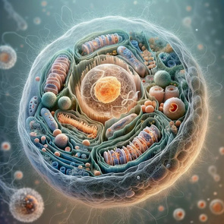
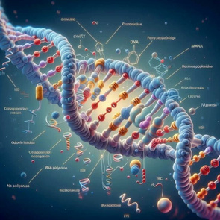
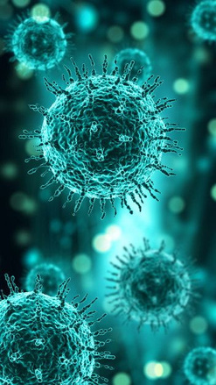
MATHEMATICAL FRAMEWORK: THE 3-PDE MODEL
Cell Density (u₁) Equation:
∂u₁/∂t = D₁∇²u₁ - ∇·[χ(u₂)u₁∇u₂] + k₃u₁[φ(u₃) - u₁]
Diffusion - Chemotaxis + Growth/Death
Chemoattractant (u₂) Equation:
∂u₂/∂t = D₂∇²u₂ + k₅u₃ψ(u₁) - k₇u₁u₂
Diffusion + Production - Decay
Stimulant (u₃) Equation :
∂u₃/∂t = D₃∇²u₃ - k₈u₁η(u₃)
Diffusion - Consumption

Slide 6
SOLVING COMPLEX BIOLOGICAL PDES:
MODELING PATTERN FORMATION: CELLS, SIGNALS & SURVIVAL
CORE COMPONENTS:
Agent
Role
Cells (u₁)
Migrate via chemotaxis; proliferate/die via reactions
Chemoattractant (u₂)
Guides cell movement (e.g., nutrients/danger signals)
Stimulant (u₃)
Modulates cell growth/decay (e.g., growth factors)

Slide 7
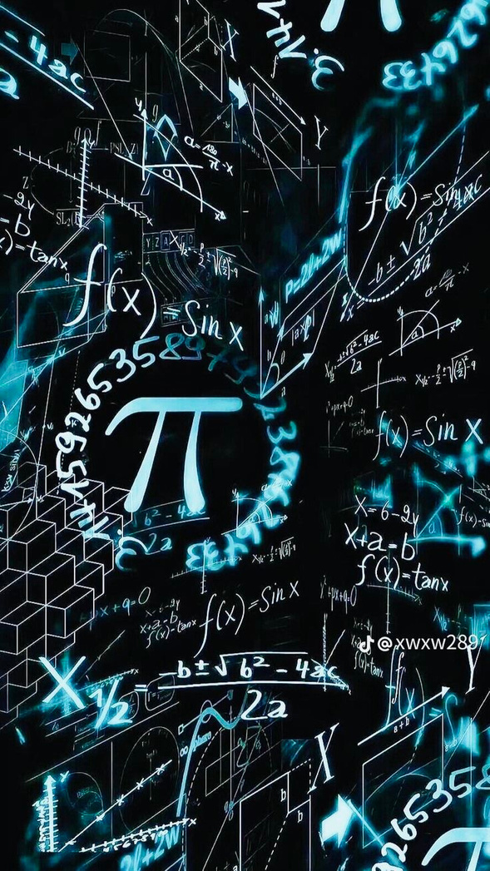
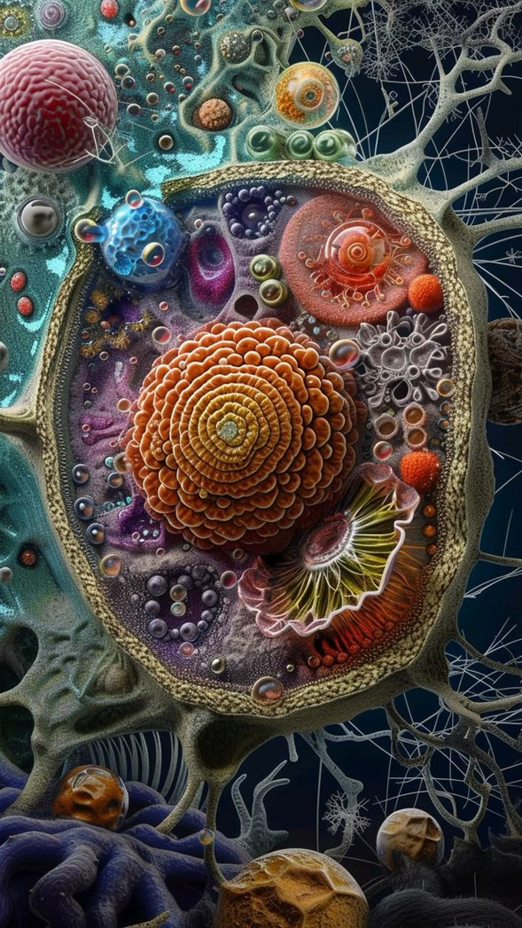
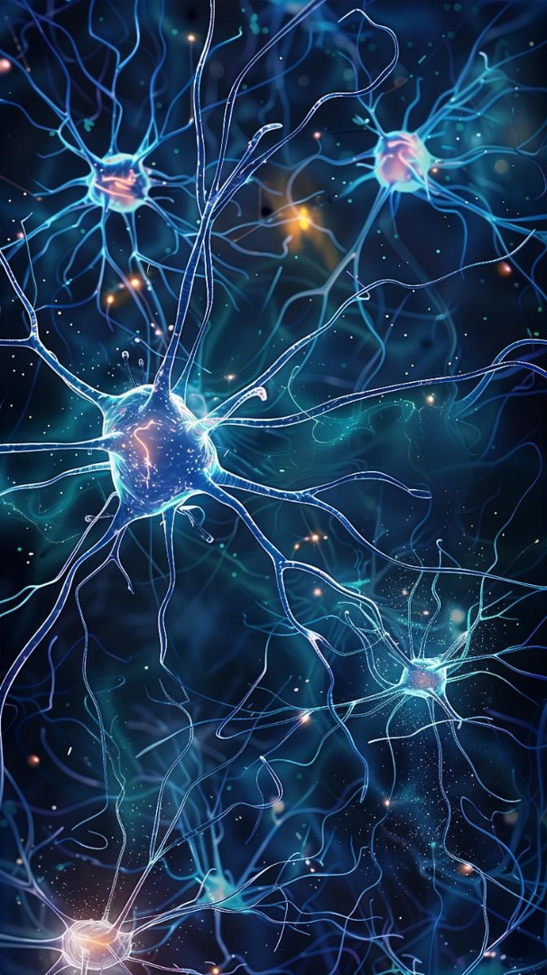
WHY THIS MODEL DEMANDS ADVANCED NUMERICS ?
NONLINEAR COUPLING
MASS CONSERVATION
STIFF DYNAMICS
Chemotaxis: χ(u₂) = k₁/(k₂+u₂)²
Cells/chemicals must balance (no artificial gain/loss)
Variables span orders of magnitude
(e.g., u₁ ~ 10⁸ cells/ml vs. u₂ ~ 10⁻⁶ M)
Reactions: φ(u₃) = k₄u₃²/(k₉ + u₃²)

Slide 8
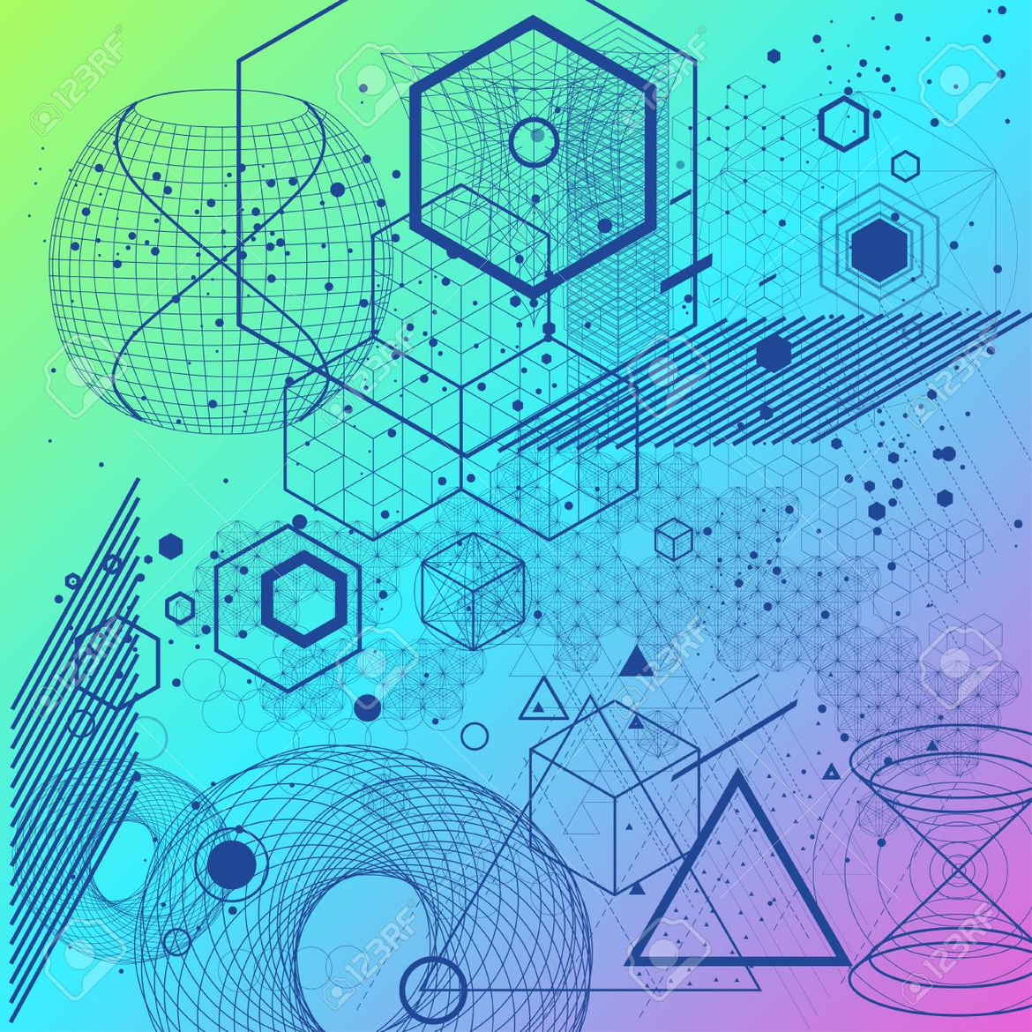
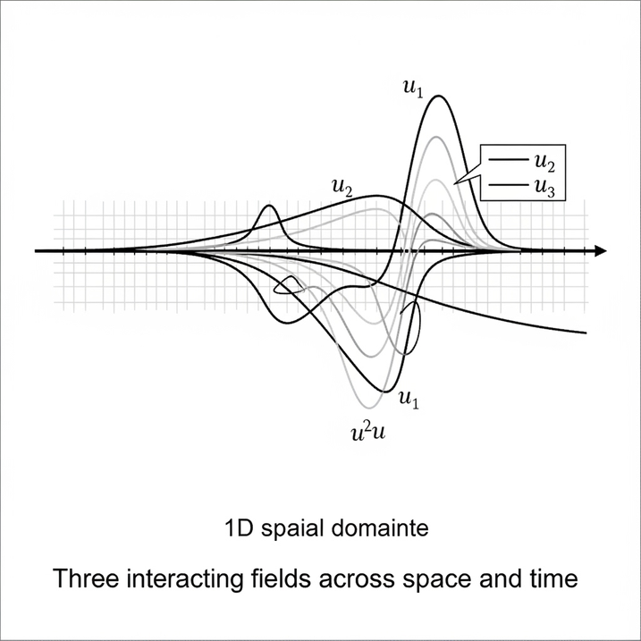
NUMERICAL SOLUTION FOR COUPLED
REACTION-DIFFUSION PDES

Slide 9
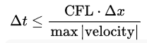
 | Book Solution | Other Paper Approach
System Type | Chemotaxis-driven (biomedical focus) | Convection-diffusion (fluid/heat transfer focus)
Numerical Approach | Structured grids + MOL + ODE solvers | Meshless GFDM + RK2
Spatial Discretization | Structured finite differences on regular grids | Meshless GFDM with Irregular Nodes
Temporal Integration | Method of Lines : ODE solver for time integration | Nonlinear terms evaluated explicitly at intermediate RK2
Stability | Relies on stiff ODE solvers | Explicit RK2 requires CFL condition

Slide 10
Similarities
Both solve nonlinear, coupled PDEs with finite difference-like methods.
Both emphasize numerical experimentation over analytical solutions.
Both demonstrate convergence and stability under grid refinement.

Slide 11
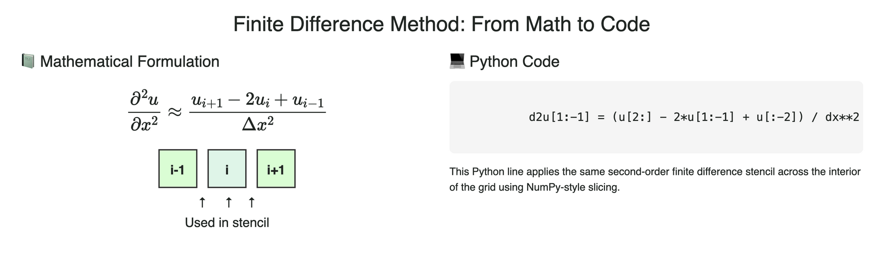

Slide 12
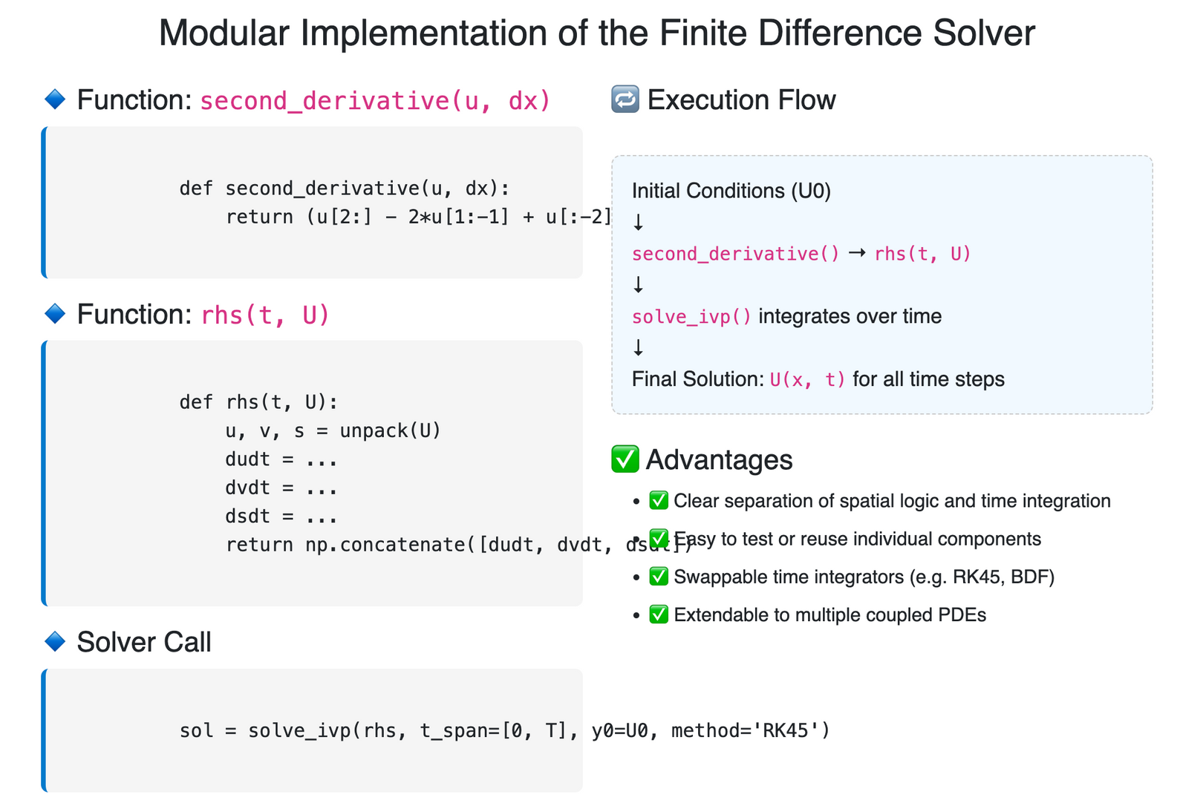
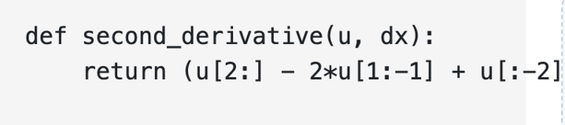

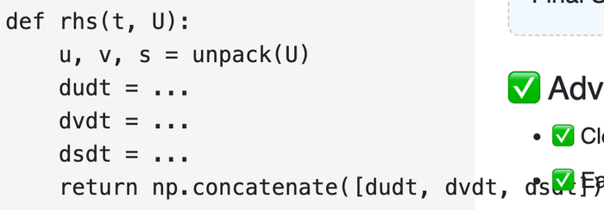
dsdt )

Slide 13
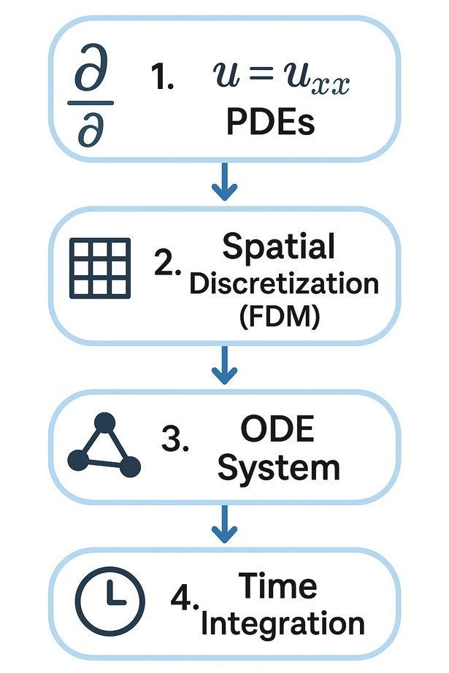
✅ Why Use the Finite Difference Method (FDM)?
A practical choice for biological PDEs in our project
✅ Simple to Implement
Discretization of time and space using Taylor expansions leads to a straightforward matrix update rule.
✅ Computationally Efficient
Sparse matrix structures and explicit schemes enable fast time-stepping with minimal memory overhead.
✅ Extensible to Systems of PDEs
Our implementation handles coupled equations (e.g., cell density, chemoattractant, stimulant) using consistent indexing and vectorized operations.
✅ Supports Various Boundary Conditions
Easily adapts to Neumann (zero-flux) or Dirichlet conditions with minor changes in ghost node logic.
✅ Easy to Debug and Visualize
The grid-based layout and step-wise updates make it intuitive for plotting intermediate states and diagnosing instability.
✅ Scales to 2D/3D Domains
The stencil approach generalizes directly to higher dimensions, making it suitable for more complex biological domains.
✅ Compatible with Stability Enhancements
Can integrate implicit or Crank–Nicolson schemes for better stability without changing the core logic.

Slide 14
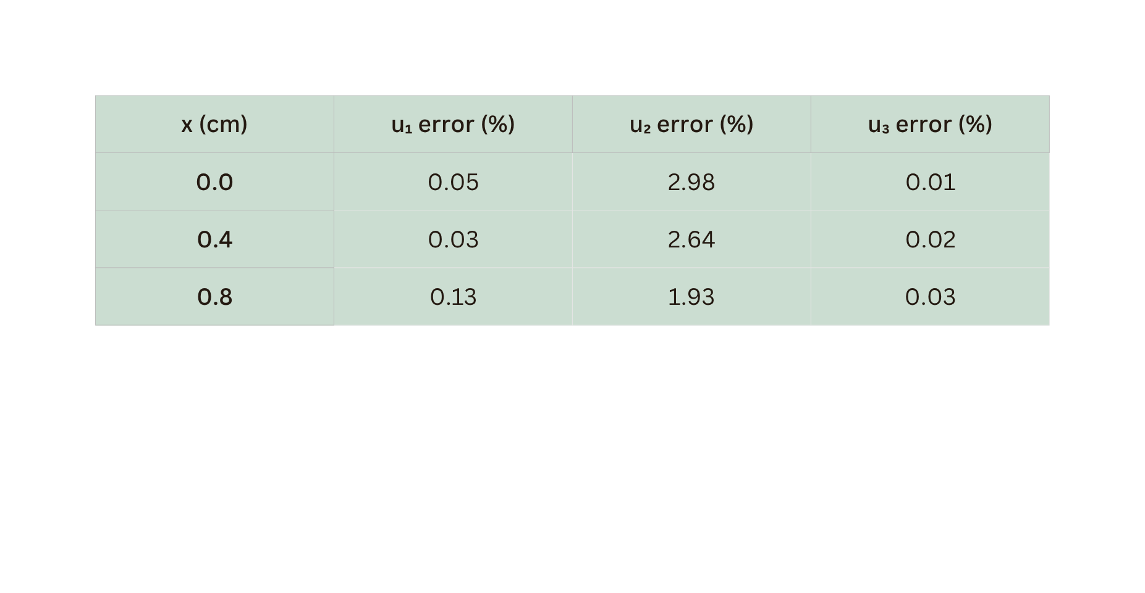
DEMONSTRATIONS AND RESULTS
AT T = 5 HOURS

Slide 15
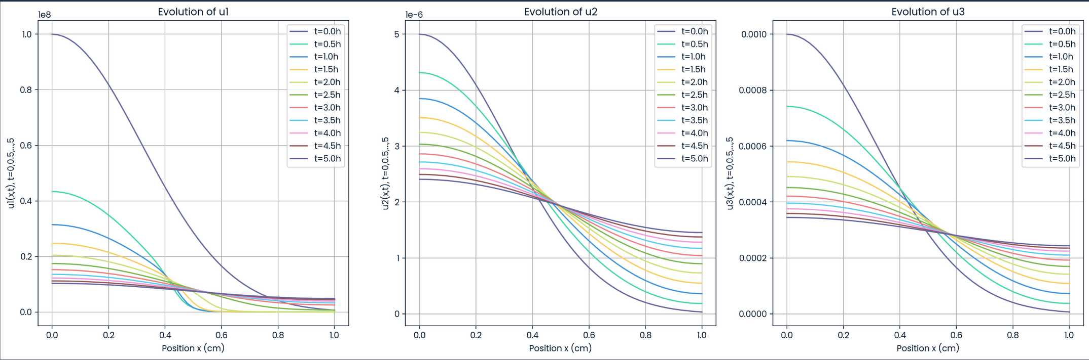
DEMONSTRATIONS AND RESULTS
AT T = 5 HOURS

Slide 16

FINITE VOLUME METHOD

Slide 17
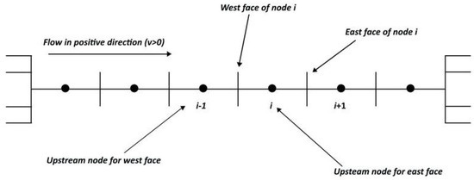
NUMERICAL SOLUTION STEPS FVM :
1- Domain Discretization

Slide 18
NUMERICAL SOLUTION STEPS FVM :
1- Domain Discretization
Divide the 1D domain 0, L into nx equally‑sized control volumes of width Δx.
Store primary variables u1,u2,u3 as cell‑averaged values at cell centers
xi=(i−½)Δx
Compute fluxes at the interfaces (cell faces) to quantify exchange between cells
Define cell centers (xᵢ) and faces (xᵢ±½)

Slide 19
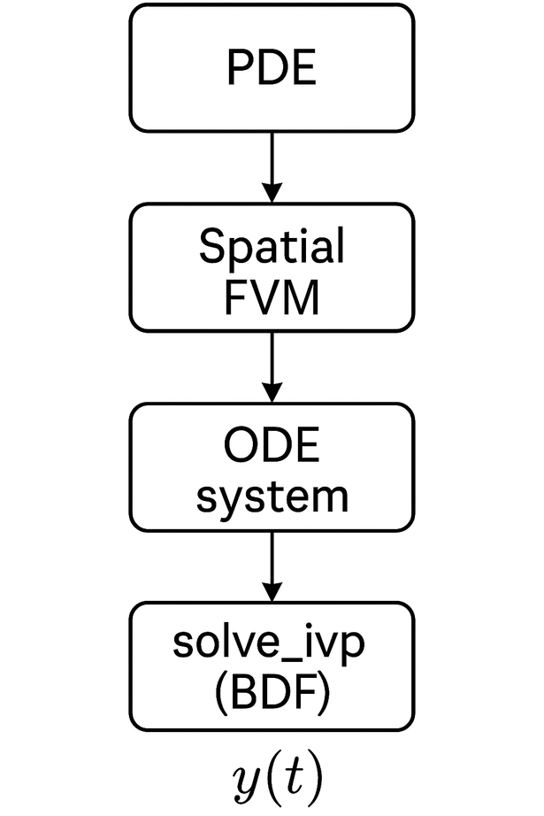
NUMERICAL SOLUTION STEPS FVM :
2 - Time Integration
Apply FVM in space to transform PDEs into a large ODE system
Use scipy.integrate.solve_ivp with the (Backward Differentiation Formula) BDF ('implicit' solver, ideal for 'stiff' problems (where things change at very different speeds).
Evaluate at discrete output times t_eval​ to track temporal evolution.

Slide 20

NUMERICAL SOLUTION STEPS FVM :
3- Flux Calculations at Cell Faces

Slide 21
NUMERICAL SOLUTION STEPS FVM :
3- Flux Calculations at Cell Faces
Diffusion flux:
J_diff,uj [i+½]=−Dj (uj[i+1]−uj[i])/Δx
Movement from high to low concentration (like food coloring spreading).
Calculated by comparing concentrations in neighboring boxes.
Boundary Condition: 'No-flux' at the edges – nothing enters or leaves the simulation.

Slide 22
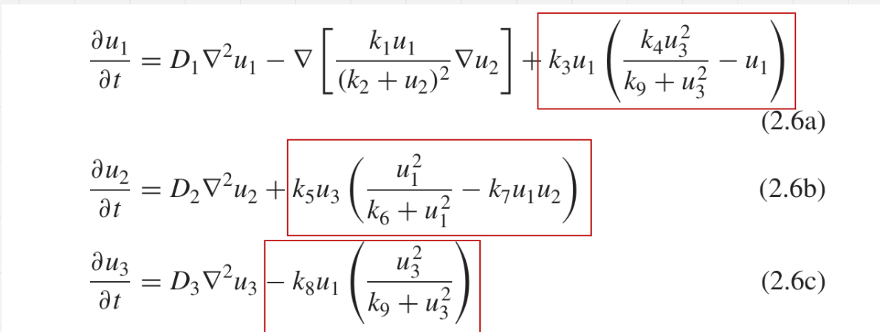
NUMERICAL SOLUTION STEPS FVM :
4- Source Term Calculations

Slide 23
NUMERICAL SOLUTION STEPS FVM :
4- Source Term Calculations
Beyond Movement: Not all changes are due to flow between boxes.
Source Terms (S1, S2, S3):Represent local production or consumption.
Examples: Cell growth, cell decay, chemical reactions.
Location: Calculated at the 'cell centers' within each box.

Slide 24
NUMERICAL SOLUTION STEPS FVM :
5 - Assembly of Time Derivatives
The Balance Equation:For each box, we sum up:
Net Flux (what came in minus what went out)
Local Source/Sink (what was produced or consumed internally)
Result: The 'time derivative' (du/dt) – how fast the 'stuff' in that box is changing.
Local Conservation: This approach guarantees that mass/quantity is precisely accounted for in every single box.

Slide 25

WHY FINITE VOLUME (FVM)?
ADVANTAGES
DISADVANTAGES
Built-in conservation
Handles discontinuities
Performed highest computation speed.
Scalability
Higher coding complexity
(vs. FDM)
Lower accuracy on coarse grids (vs. high-order FEM/FDM)
Stability

Slide 26
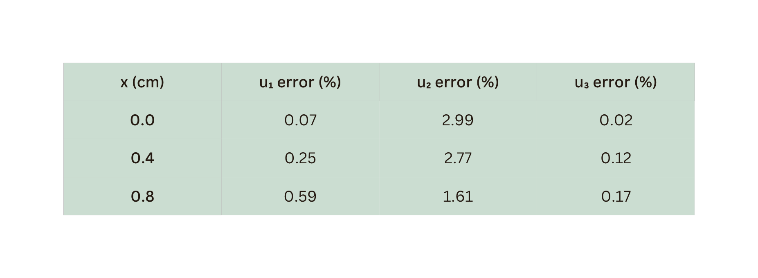
DEMONSTRATIONS AND RESULTS
AT T = 5 HOURS

Slide 27
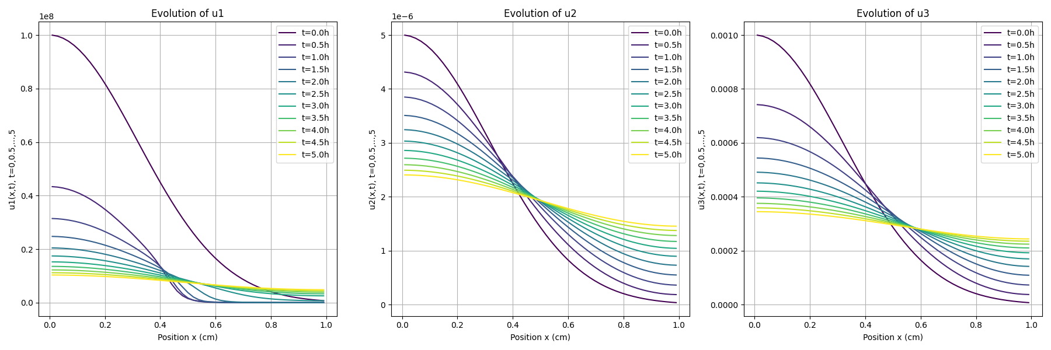
DEMONSTRATIONS AND RESULTS
AT T = 5 HOURS

Slide 28
SOLVING PATTERN FORMATION WITH MACHINE LEARNING
PDE Model
Definition
Convert biological equations through class PatternFormationPDE
Define parameters: diffusivities D1-D3, rate constants k1-k9
Solution Storage
Store data and times
Track states at 0.5hr intervals
Create 1D grid (51 support points)
Apply Neumann BCs (zero-flux)
Set up initial state
Spatial Discretization
Adaptive
Solver
Use Scipy's BDF solver (adaptive time-stepping)
Calculate diffusion, chemotaxis, stimulate terms
Solution Visualization
Extract data
Print the last state at t = 5 hours
Plot Results

Slide 29
WHY PY-PDE ?
SEAMLESS SCIPY INTEGRATION
FREE/OPEN-SOURCE
No licensing costs; community-driven development.
Works with NumPy, SciPy, and Matplotlib for pre/post-processing.
AUTOMATIC BC HANDLING
PERFORMANCE
Simplifies setup with built-in boundary conditions (Dirichlet, Neumann, etc.).
Leverages Cython for critical loops; supports GPU acceleration via CuPy.

Slide 30
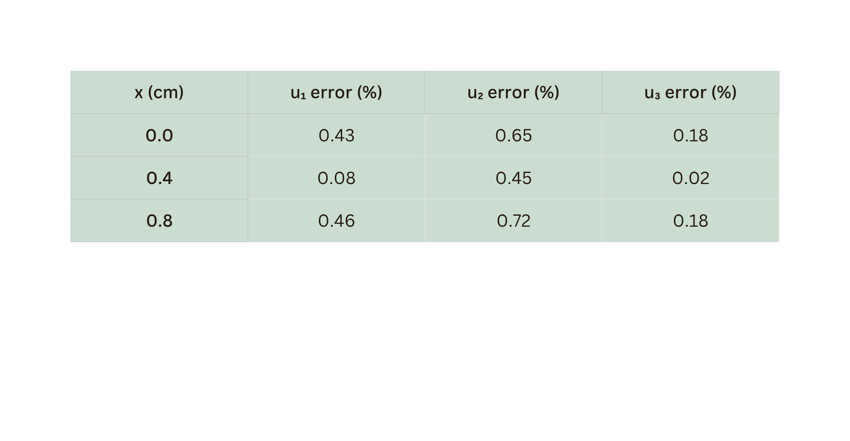
DEMONSTRATIONS AND RESULTS
AT T = 5 HOURS

Slide 31
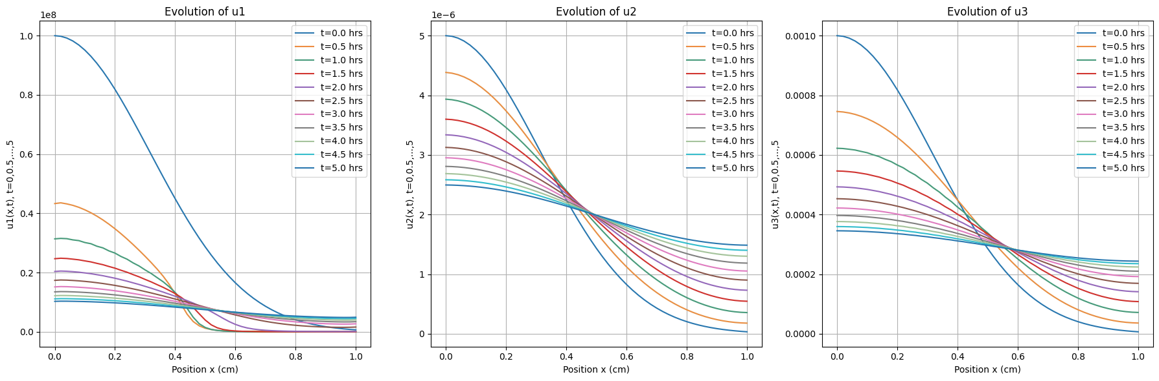
DEMONSTRATIONS AND RESULTS
AT T = 5 HOURS

Slide 32
SOLUTIONS ACCURACY
COMPARED WITH BOOK RESULTS
LEARNING-BASED
FVM
FDM
MAX(%)
MIN(%)
MAX(%)
MIN(%)
MAX(%)
MIN(%)
U1
1.98
0.04
U1
0.59
0.07
U1
0.17
0.03
U2
0.72
0.36
U2
3.11
1.61
U2
2.98
1.75
U3
0.18
0.01
U3
0.17
0.02
U3
0.03
0.01

Slide 33
TIME METRICS
MOL
LEARNING-BASED
FVM
FDM
Runtime
(sec)
1.826
6.446
1.132
1.881
Problem Size
(no. equ’s)
153 ODEs
153 ODEs
153 ODEs
153 ODEs
time/equ
(s/equ)
0.0119
0.0452
0.0074
0.0123
Function Evaluations
1052
3717
945
1052

Slide 34
Suggestions for Improvements
MODEL EXTENSIONS
ALGORITHMIC ENHANCEMENTS
• Spatial Dimension Expansion: Extend to 2D/3D do-
mains for realistic biological pattern simulation
• Stochastic Terms: Introduce noise terms for ∂ui/∂t to
model microenvironment variability
• Parameter Estimation: Integrate neural ODEs for data-
driven parameter calibration
• Adaptive Mesh (h Refinement): Increase number of
support points in the grid
• High-Order Time Integration (p Refinement): Use 6th
order FD approximations instead of 4th order ones

Slide 35
Future Research Directions
DEEP LEARNING INTEGRATION
BIOLOGICAL APPLICATIONS
• Hybrid Solver: Show the computer microscope photos
of real cells to set up better simulations, then use CNN
encoder to generate initial conditions from microscopy
images
• Operator Learning: Train Fourier Neural Operators
(FNOs) to predict patterns without solving complex equa-
tions
• Uncertainty Quantification: Implement Bayesian
PINNs for solution confidence intervals
Cancer Research: Simulate how tumor cells invade healthy tissue
Drug Delivery: revolutionize drug design by simulating how smart medicines navigate biological systems

Slide 36
Team Members:
Ahmed Abdelghaffar
Sherif Elgendy
Anas Elshiekh
Mostafa Ashraf
Mohammed Hagras
Sief Samaan
Ziad Ramadan
Mazen Atlam
THANK YOU!
ANY QUESTIONS?

